Slide 1
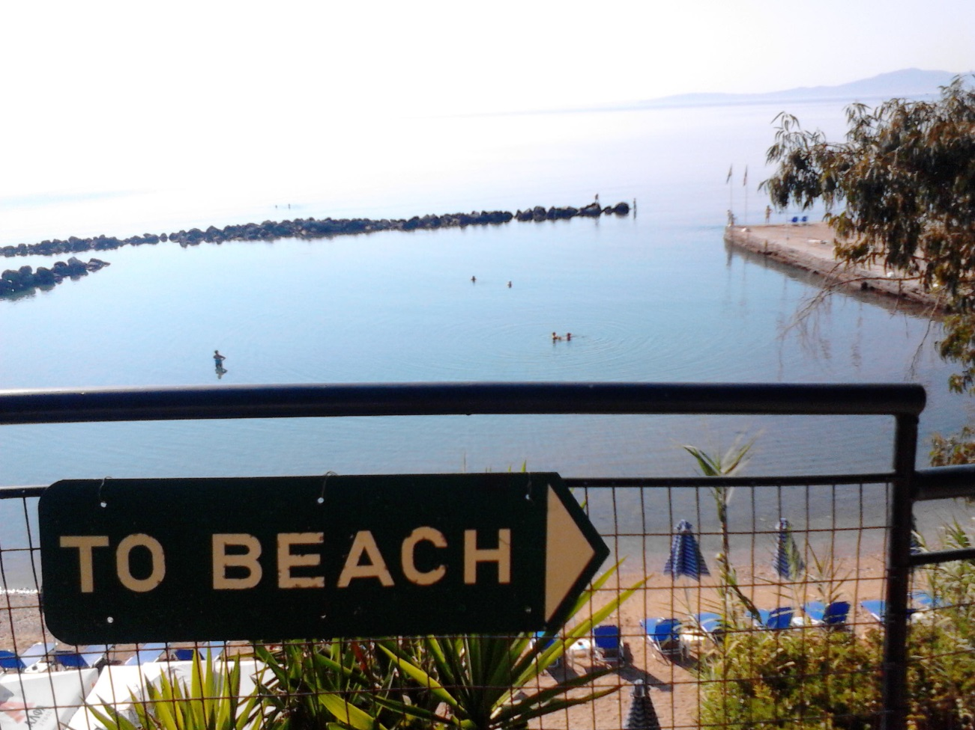
Adventures on Corfu
Zoltán Szőr
Brownbag lunch seminar 12:30 02.10.2015. @ Atomki VIII. 2nd floor seminar room opposite to the stairs

Slide 2
Enjoy your pizza!
First of all….

Slide 3
Summer School and Workshop on the SM and Beyond
Talk about my participation and impressions @

Slide 4
Summer School and Workshop on mainly SUSY/Higgs and some other stuff…
Talk about my participation and impressions @

Slide 5
Location
Part I.

Slide 6
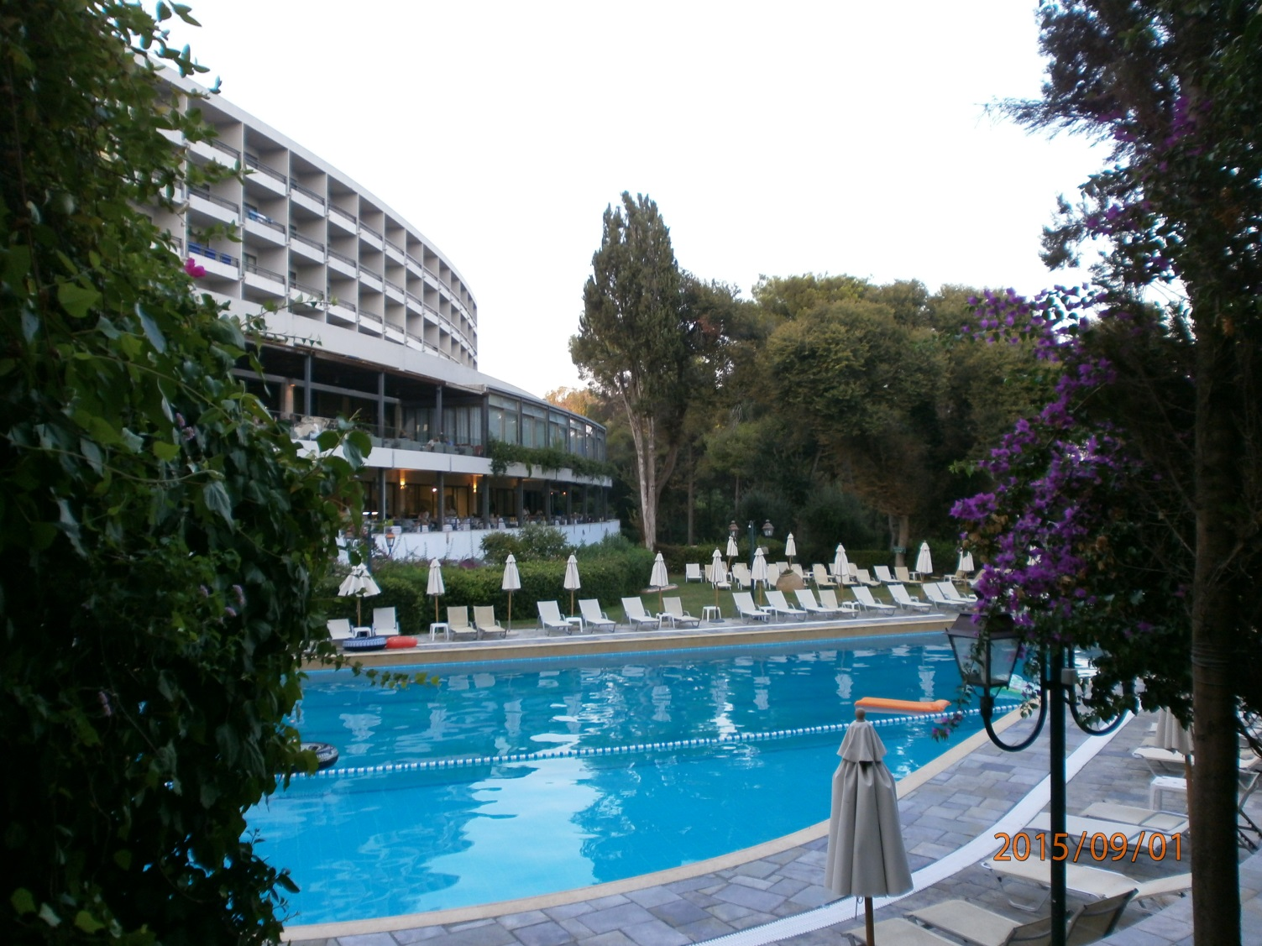
Corfu Holiday Palace
5 star hotel with nice things like:

Slide 7
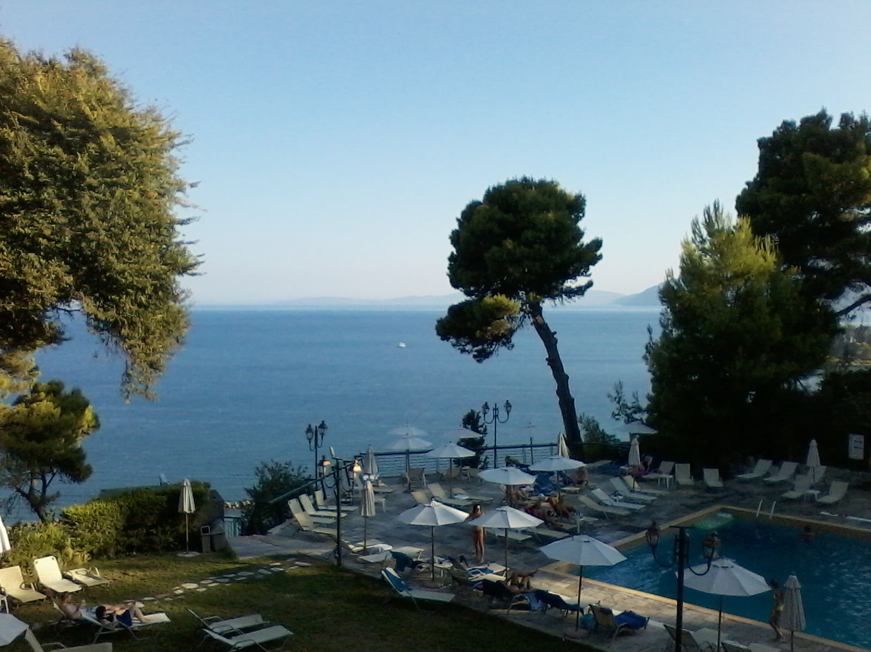
Corfu Holiday Palace
5 star hotel with nice things like:

Slide 8
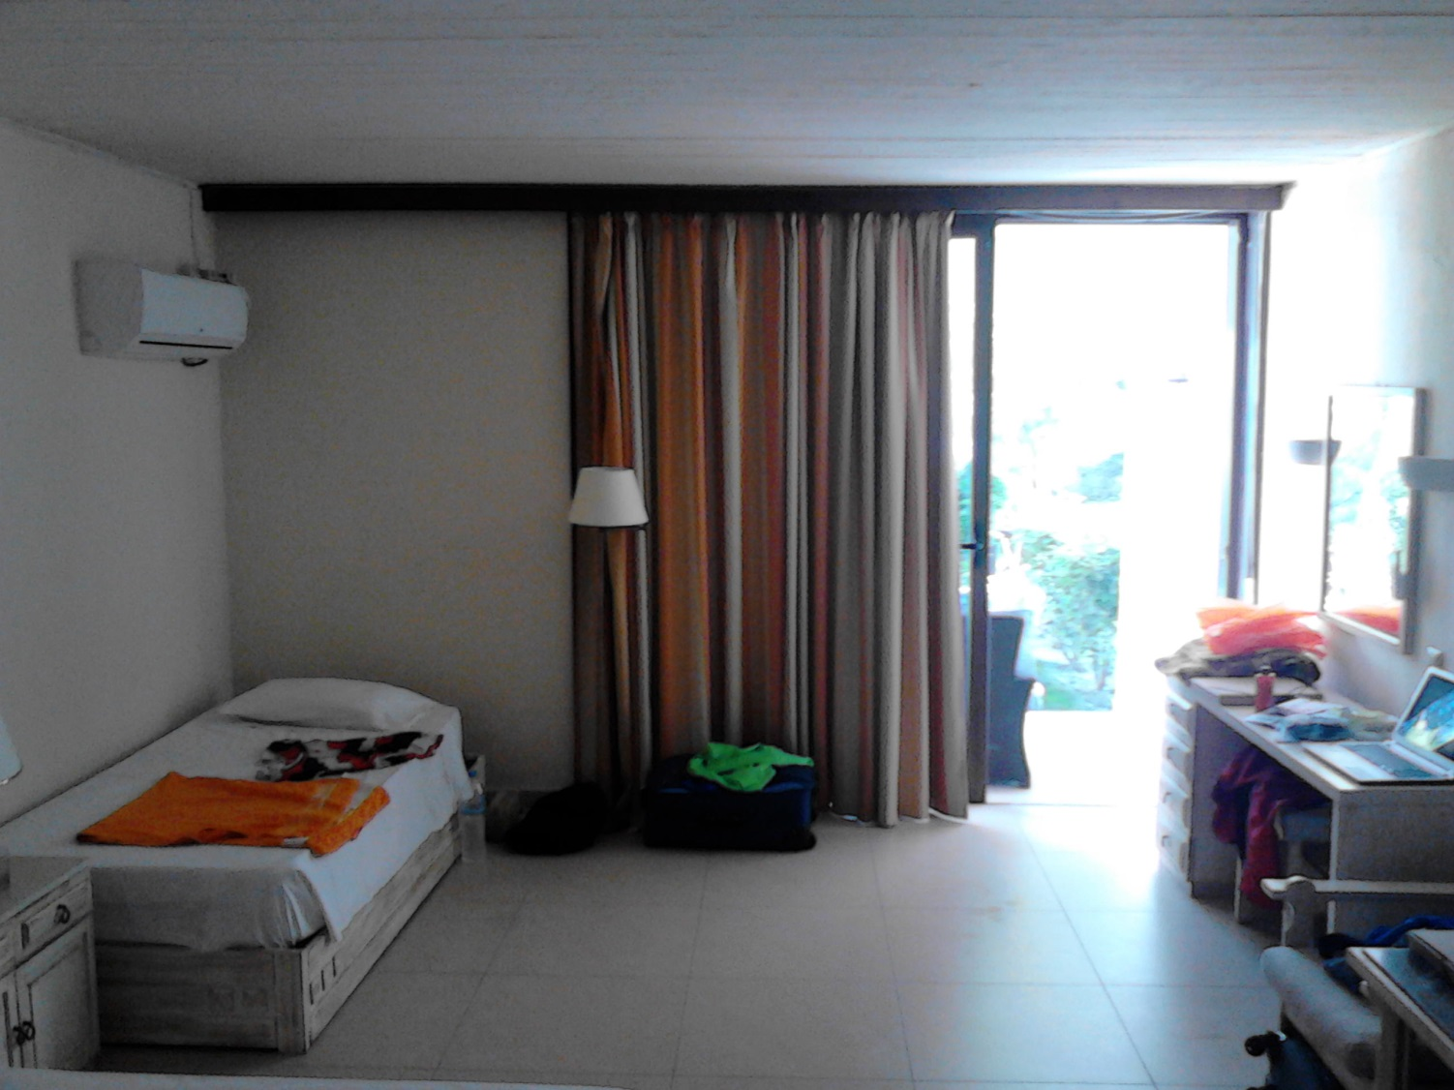
Corfu Holiday Palace
5 star hotel with nice things like:

Slide 9
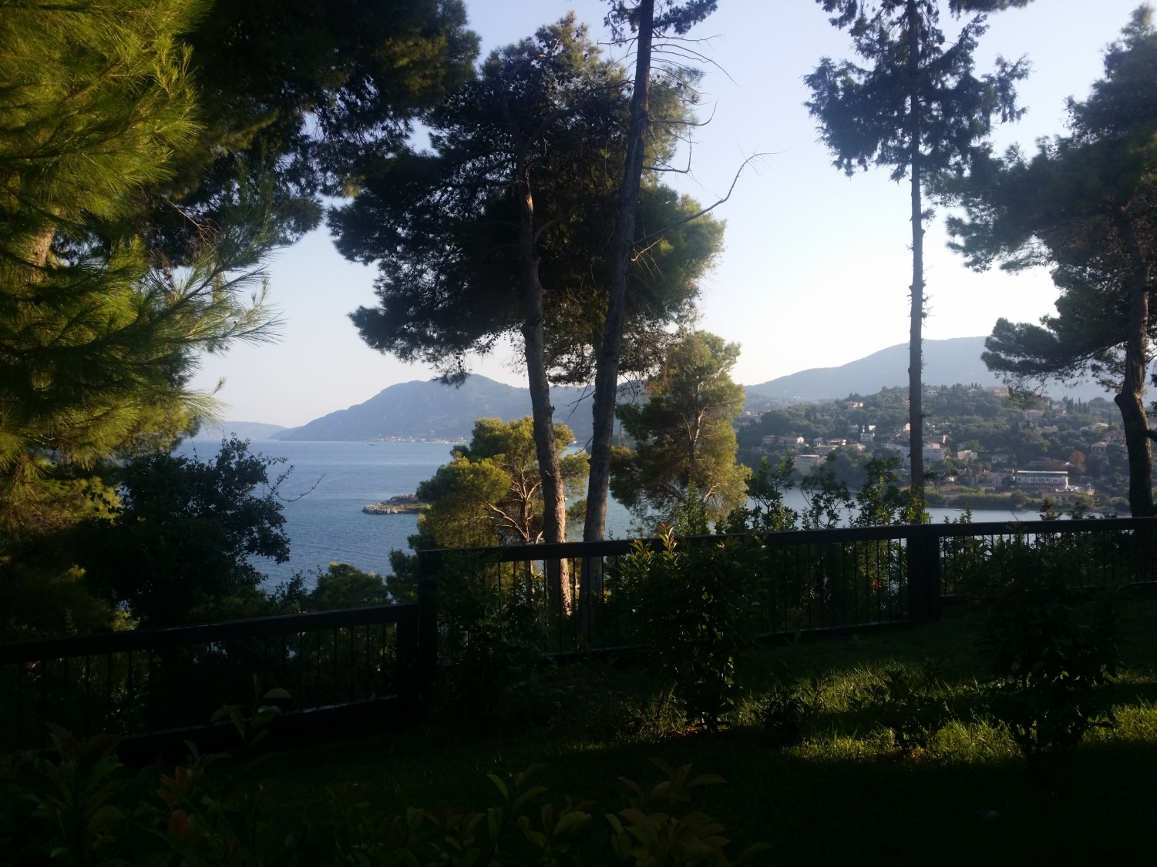
Corfu Holiday Palace
5 star hotel with nice things like:

Slide 10
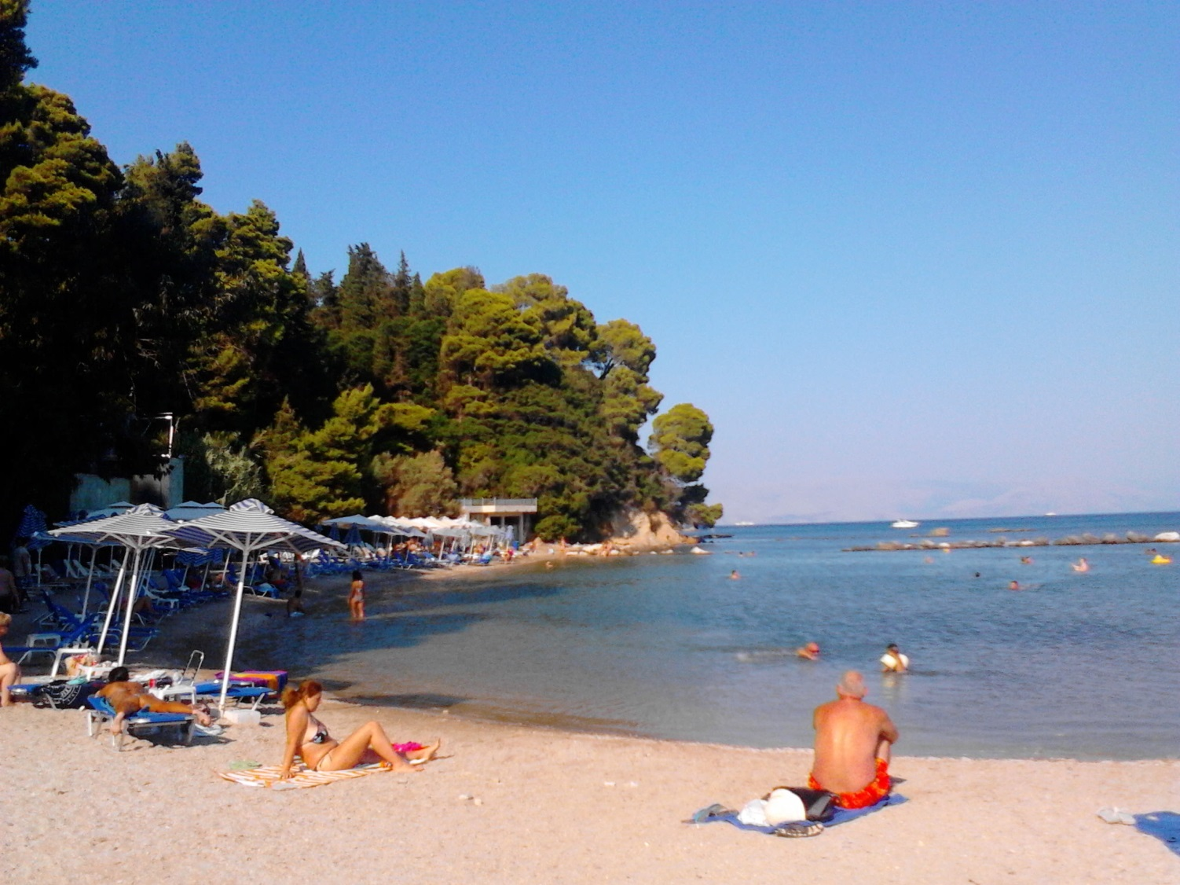
Corfu Holiday Palace
5 star hotel with nice things like:

Slide 11
Corfu Holiday Palace
5 star hotel with nice things like:
No running water if it rained a lot last night

Slide 12
Talks
Part II.

Slide 13
Topics
Roughly 54 lectures (1 hour) and workshop talks (30 min) about:
New LHC data
Future accelerators
Neutrinos
CP violation
Flavour physics
Astroparticle, cosmology
Dark matter
Electroweak
QCD
Etc.

Slide 14
Topics
BUT!
~18 about (SUSY) Higgs (multiplets)
~10 about SUSY
(mainly theory lectures, what I’m actually interested in)
20-25% of total lectures more or less covered the same two topics!

Slide 15
Favourite lectures
D.Stockinger – Electroweak SM
Basics
Some tree level results (with SUSY extension of course)
Formulation of quantum gauge theories via equivalence classes, BRS transformations, etc. (it was really nice)
Renormalization of SM
Loop results for important processes

Slide 16
Favourite lectures
W.Hollik – Introduction into SUSY and MSSM
SUSY algebra
Supersymmetric SM formulation with superfields
Description of MSSM
Tests for the MSSM

Slide 17
Favourite lectures
F.Lizzi – Noncommutative geometry, spectral action and the Higgs
Formulation of the SM in a geometric language
Prediction to the Higgs mass (~175 GeV)
Extension of SM with higher symmetry

Slide 18
Favourite lectures
J.P. Derendinger – SUSY/SUGRA
Introduction to SUSY (feelt a little bit more intuitive than Hollik’s)
Superfield formulation
Local supersymmetry → gravity
Supergravity

Slide 19
Favourite lectures
G. Zanderighi - QCD
Mainly introductory lecture to QCD (Zoltan’s book)
Colorful subtraction on the slides!
(But NNLO was skipped because of lack of time)

Slide 20
Favourite lectures
E. Kiritsis – Introduction into string theory
???????
(but I liked it)

Slide 21
Favourite lectures (the last one I promise)
H. B. Nielsen - Prediction of some deviation in Higgs production and decay to gammas from pure Standard Model (due to bound state of 12 top-quarks)

Slide 22
Observations during talks
People are „obsessed” with SUSY
If you have any kind of problem you just introduce some new fields and/or symmetries
(We have actually „no idea” what is beyond SM)
Experimental plots are still way too busy..
Microphones are the archenemies of physicists

Slide 23
sudo make paper
Let me introduce SARAH, the ultimate model builder tool

Slide 24
Highlights
Part III.

Slide 25
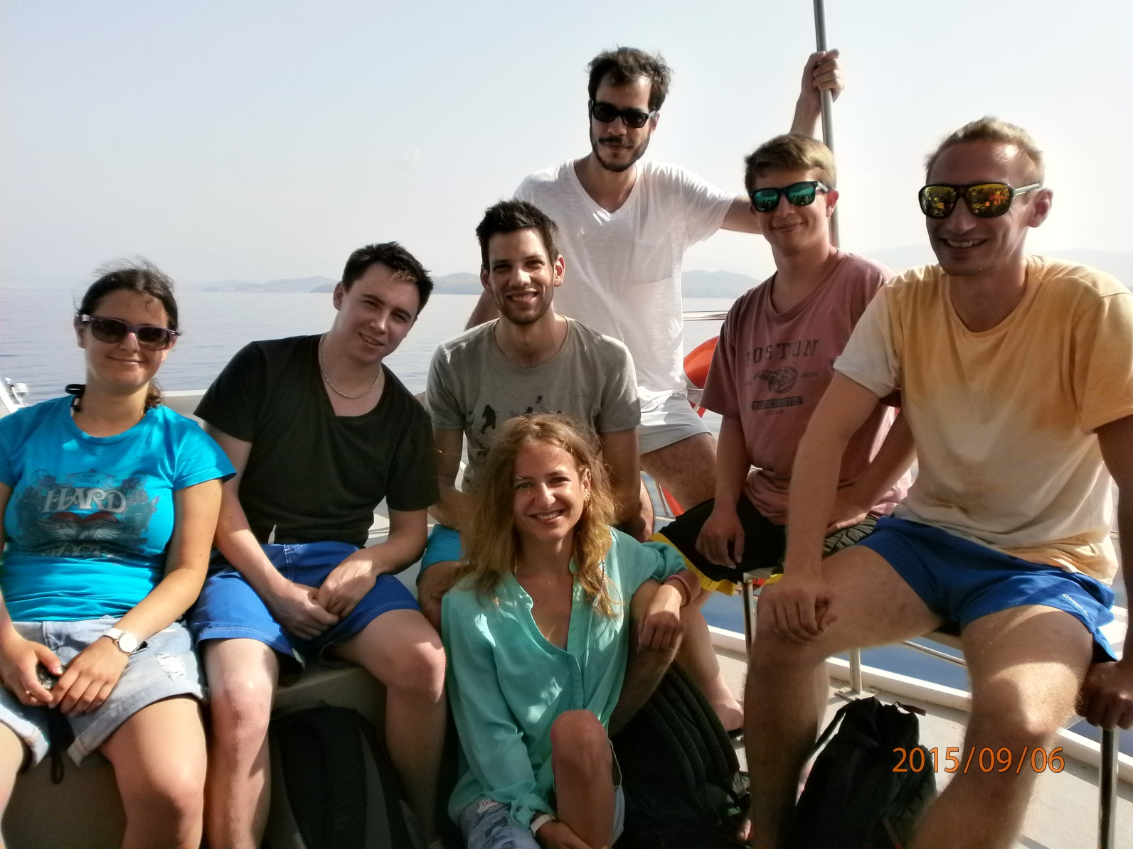
Meeting new people

Slide 26
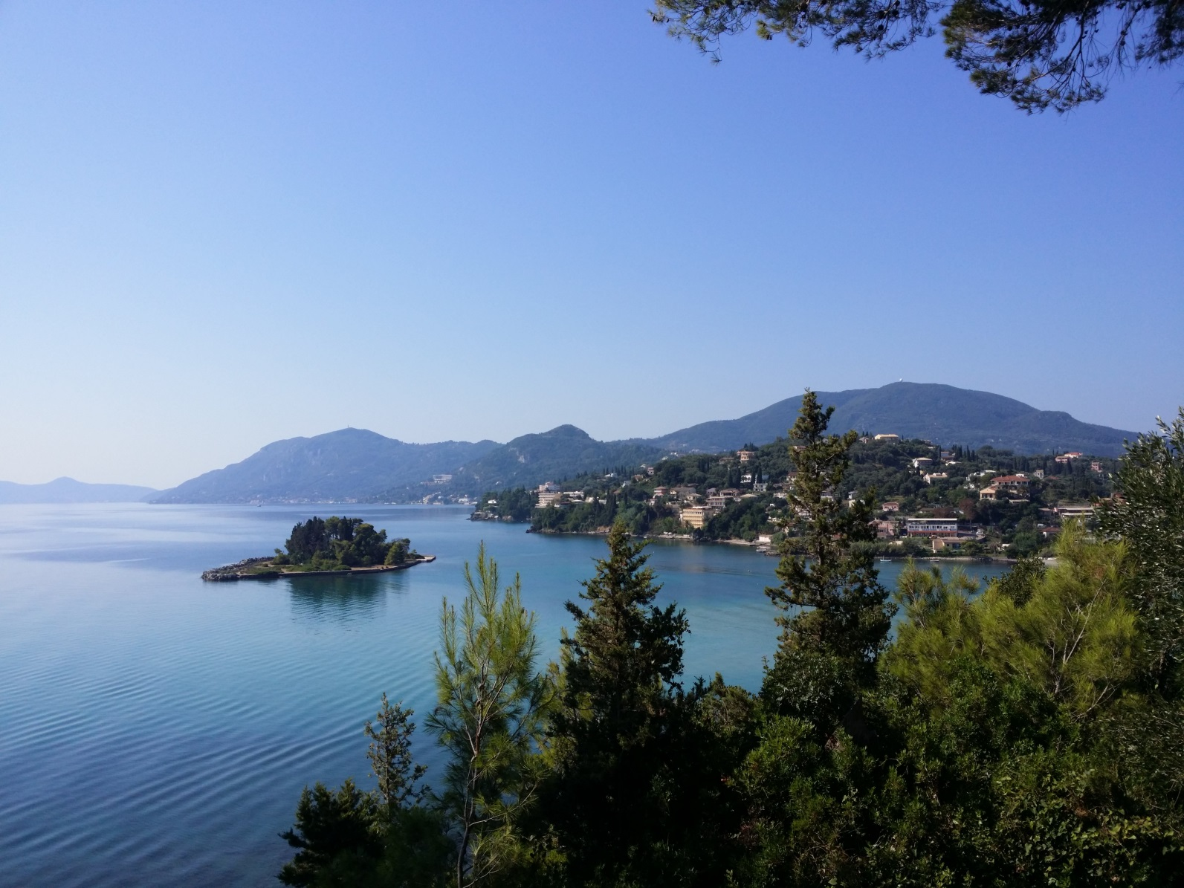
Swimming to the island (twice)

Slide 27
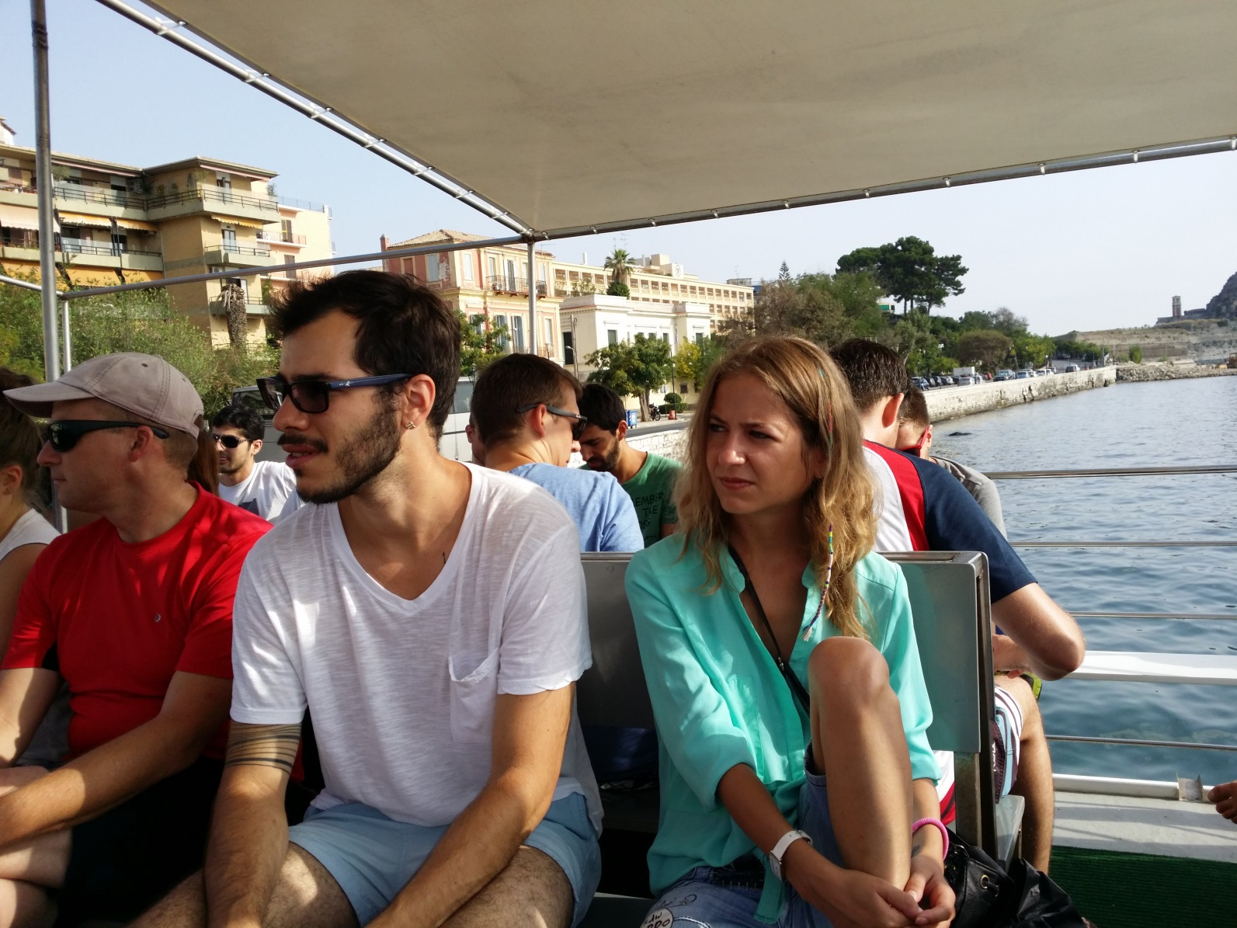
Boat trip
He is Thomas Hahn

Slide 28
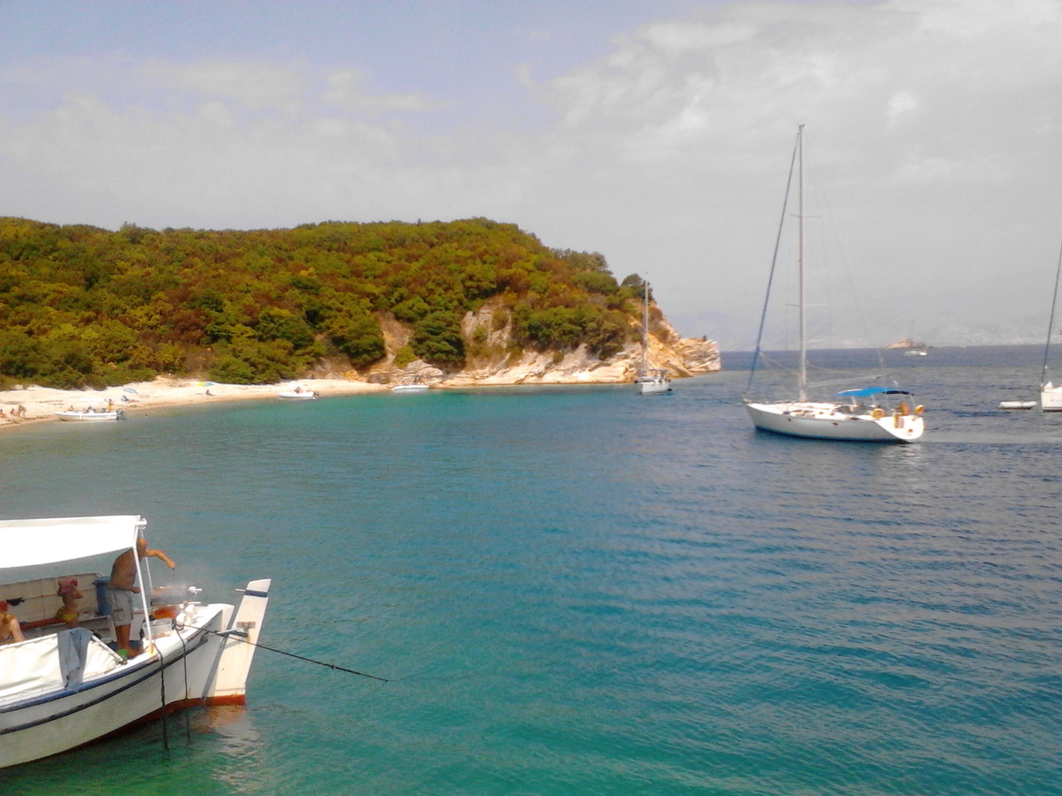
Boat trip

Slide 29
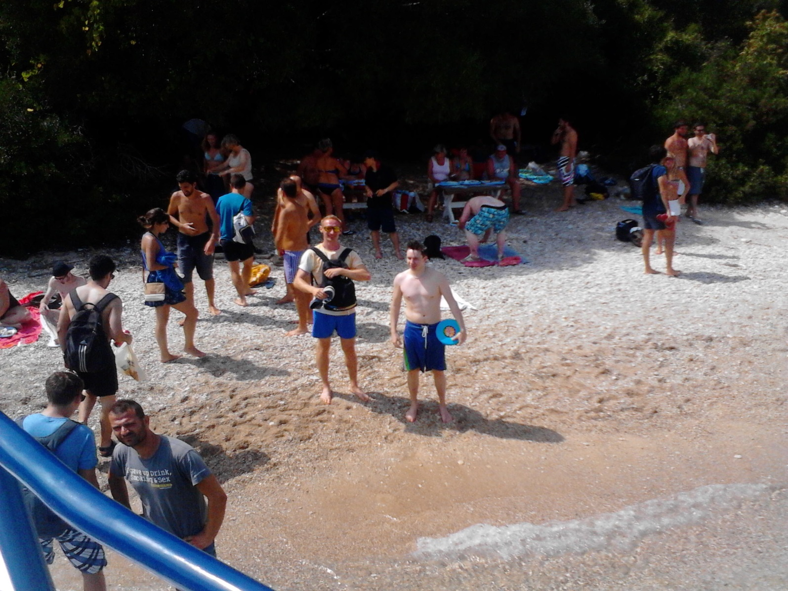
Boat trip

Slide 30
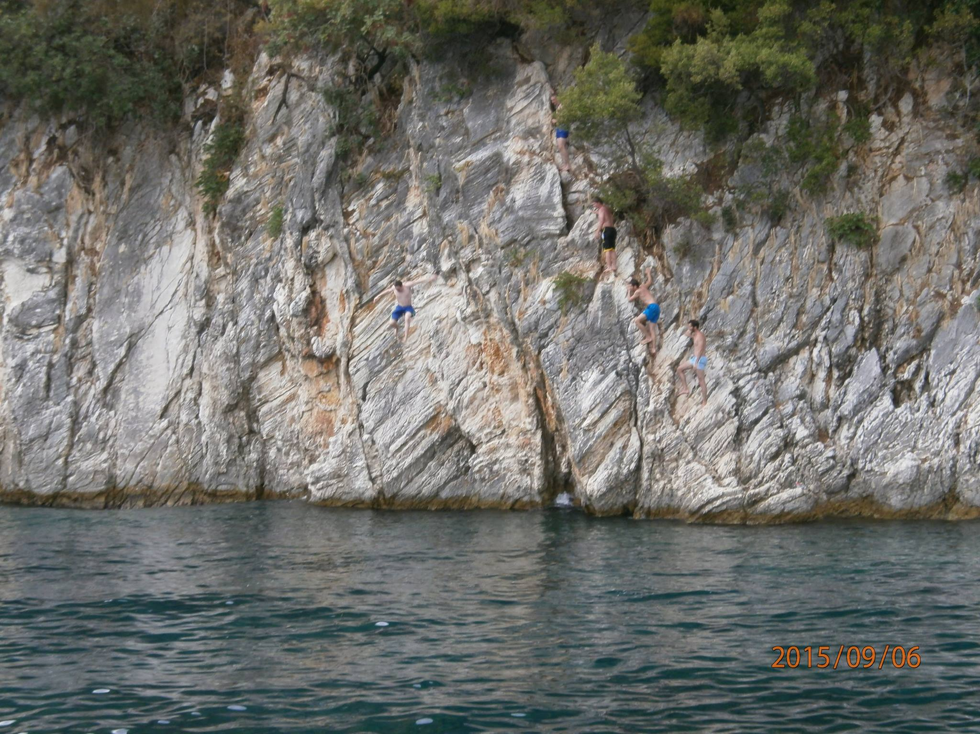
Measuring the g by freefall

Slide 31
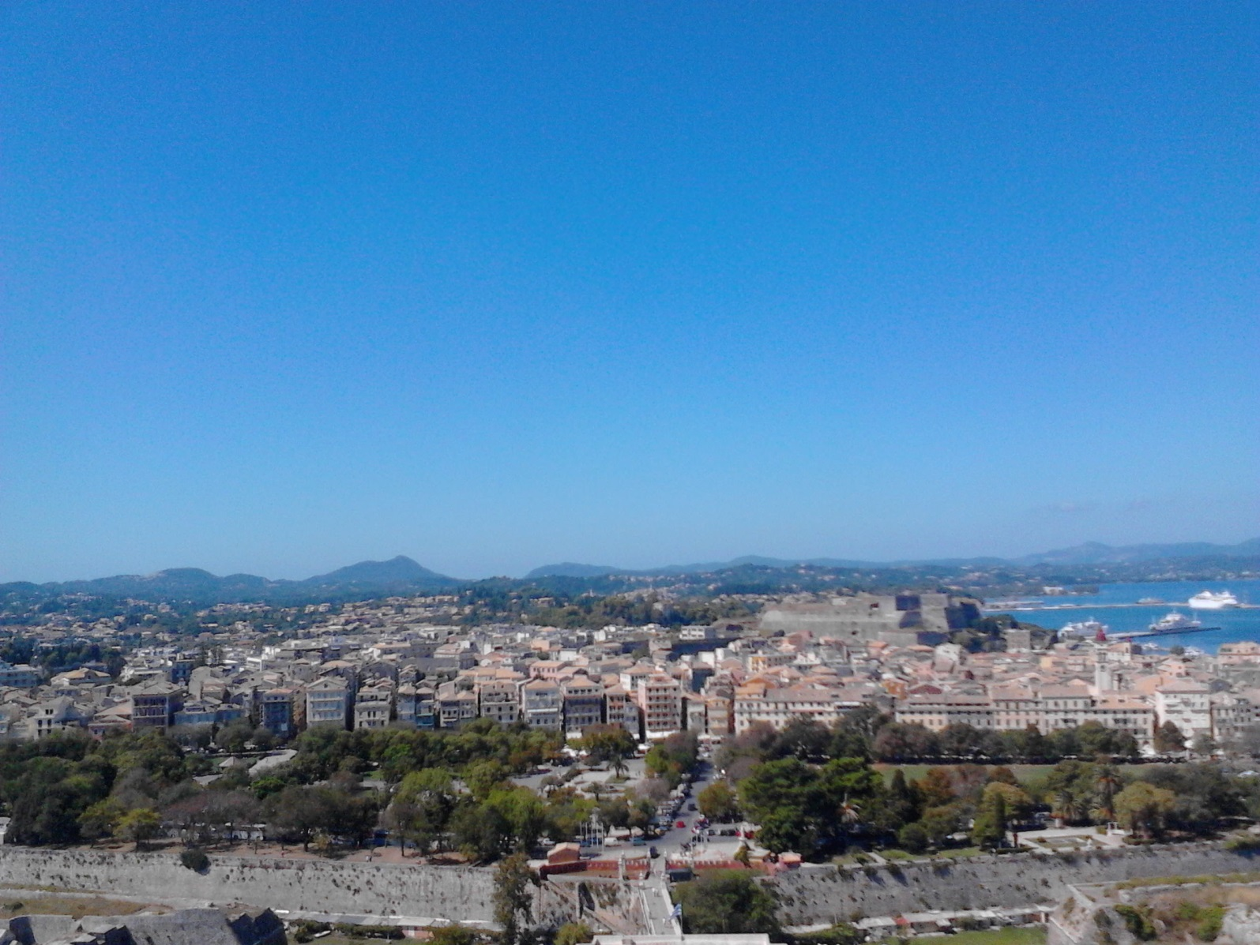
Corfu town (Venice)

Slide 32
Nielsen

Slide 33
Summary
I had a really good two weeks
There were really good and interesting lectures (and some bad ones also)
We had good discussions
I don’t want to work on SUSY…

