Slide 1
Physicists in materials science Traitors or missionaries?
Peter de Chatel
New Mexico State University
26 July 2012
In the Lion’s Den

Slide 2
Theoretical physicists in metallurgy?

Slide 3
String theorist seeks career as guitarist
Is this high treason, or spreading the Word to the uneducated?

Slide 4
Are there divisions in physics?
Theoretical vs Experimental?
Big physics vs Small physics?
The poles of the division:
(pole: either of two opposite or contrasting extremes)
High-energy physics Solid-state physics
separate budgets (CERN, clever?) supported by industry (clever?)
astronomy, philosophy chemistry, metallurgy
theory of everything technological breakthrough
Nobel prize MegaNobel
sponsoring
allies
goals
ambitions

Slide 5
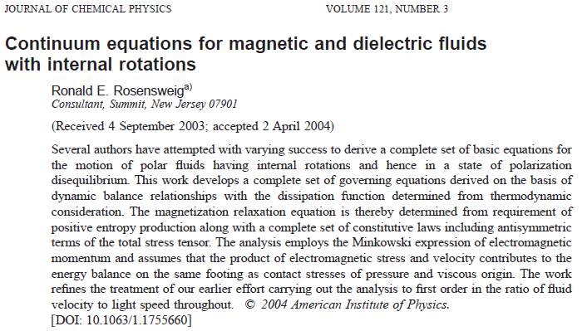

Slide 6
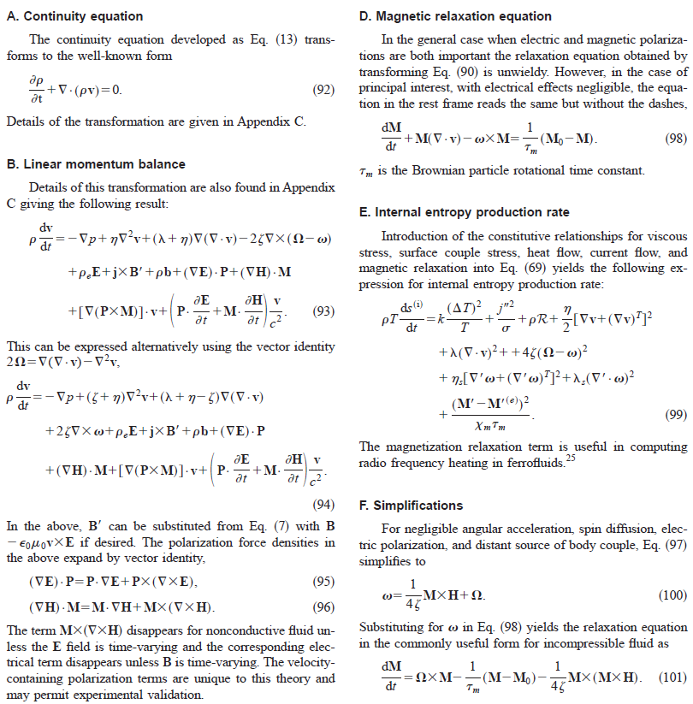

Slide 7
The rest is engineering
The rest is engineering
The rest is engineering
The rest is engineering
The rest is engineering

Slide 8
The rest is engineering
------------------------------
The rest is engineering
------------------------- -----
The rest is engineering
-----------------------------
The rest is engineering
------------------------------
The rest is engineering
-------------------------------

